Slide 1

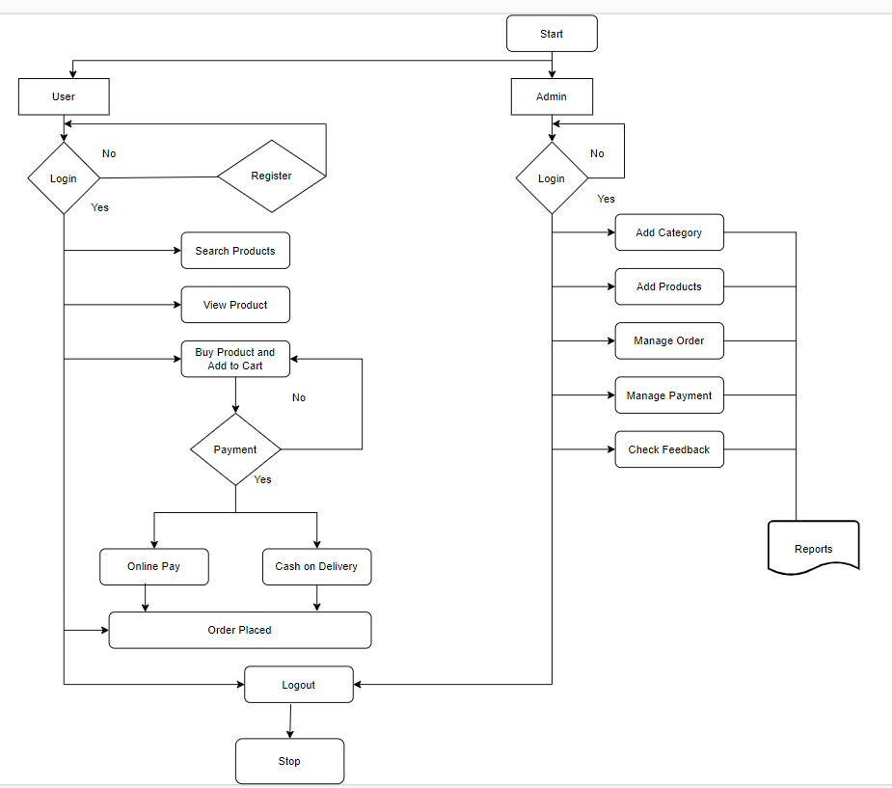
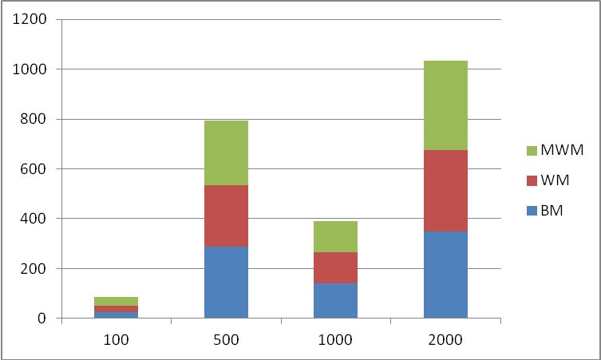
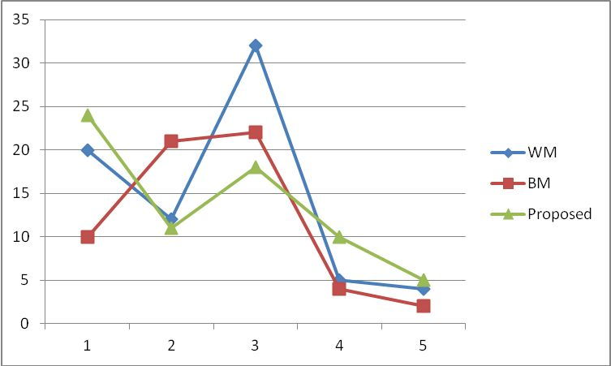
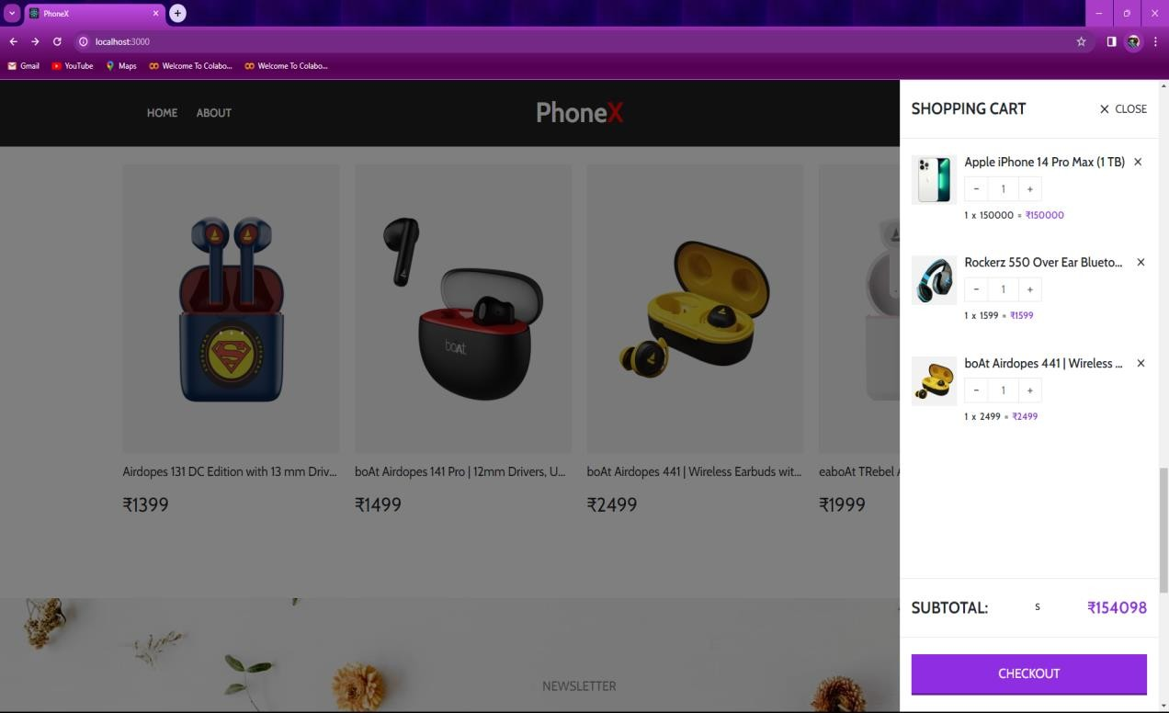
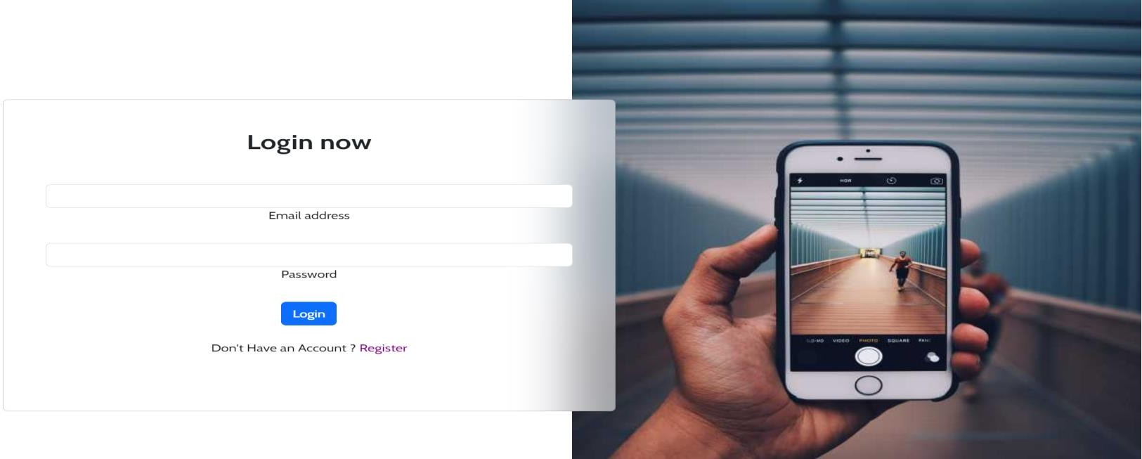
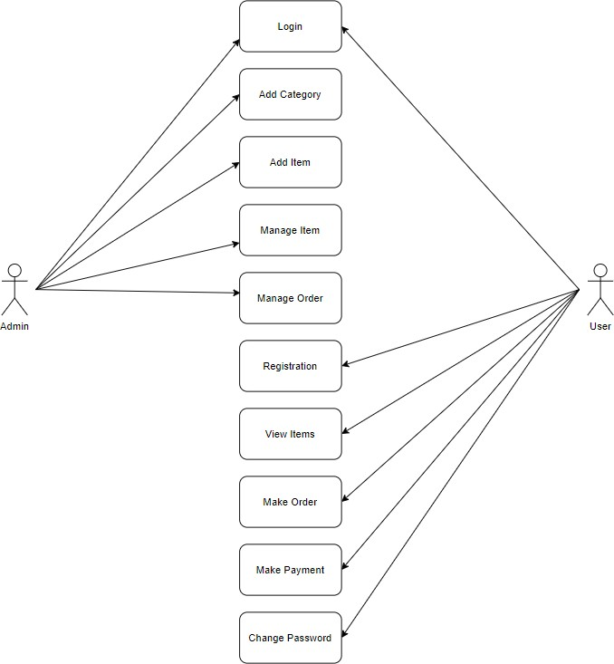
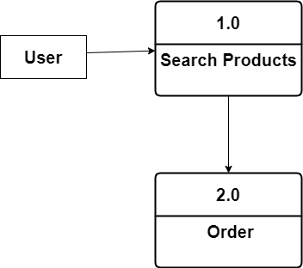
COT-P1
PhoneX
1. Deval Darji (200103042090)
Guided by
Prof. Ami charavada
Silver Oak College Of Engineering and Technology, College of Technology, SOU
INTRODUCTION
SYSTEM FLOW with Experiments and Results
In the present scenario, the biggest market for this (online shopping) business is by highly educated people, mostly. This system has been designed keeping in mind all the aspects such as loading the data, complexity, and maintaining the security of user credentials. Here in this system, complexity refers to the total number of features being provided to users, and their smooth arrangement and functioning required.
Comparison of time taken at good efficiency level
GOALS & OBJECTIVES
Manage the shopping details: The whole system of online shopping manage the detail of each shopping done by the customers. They extract the product details of what consumers shopped.
Manage the payment details: In online shopping, customers get many options for mode of payments. Websites give them the option of online payment through debit or credit cards. Customers have also the option of net banking or cash on delivery payment option. It is the objective of an online shopping system to manage all the payment details of each product.
TECHNIQUES USED
Fig 1. Algorithm to execute the MWM Fig 2 display of comparison of charts
IMPLEMENTATION
Frontend: .
Backend: .
Database:.
Authentication:
Payment Integration:
ALGORITHM USED
User Registration and Authentication
Browse Menu
Search and Filter
Order Placement
Order Tracking
USE CASE / LEVEL 1 DFD’S
FUTURE SCOPE
1. Enhanced User Experience
2. Expansion of Services
3. Integration with Emerging Technologies
Comparison of Different Criterias (if any else you can remove this section and resize the above section)
CONCLUSION
E-commerce has bloomed over the years and is one of the fastest-growing domains in the online world. Though it took some time for this to be accepted by the end-users, today we are at a point where the majority of the people love to shop online. There were numerous concerns revolving around online shopping at its launch, but over the years people have started to trust E-commerce for all their shopping needs. The scope of ecommerce is vast. In India, people prefer shopping online these days rather than having to visit the physical store. The payment features that are smart and secure as well as the cash on delivery (COD), which makes the payment, even more, safer with hassle-free shipping, easy returns and reach out.
.
AMAZON
Flip Cart
Myntra
Online Sale
Super sale
Online Shopping
Summer Sale
Digital shopping
REFERENCES
W3Schools Online Web Tutorials
Introduction · Bootstrap v5.0 (getbootstrap.com)

